Slide 1
Unit-ii
DATA MINING

Slide 2
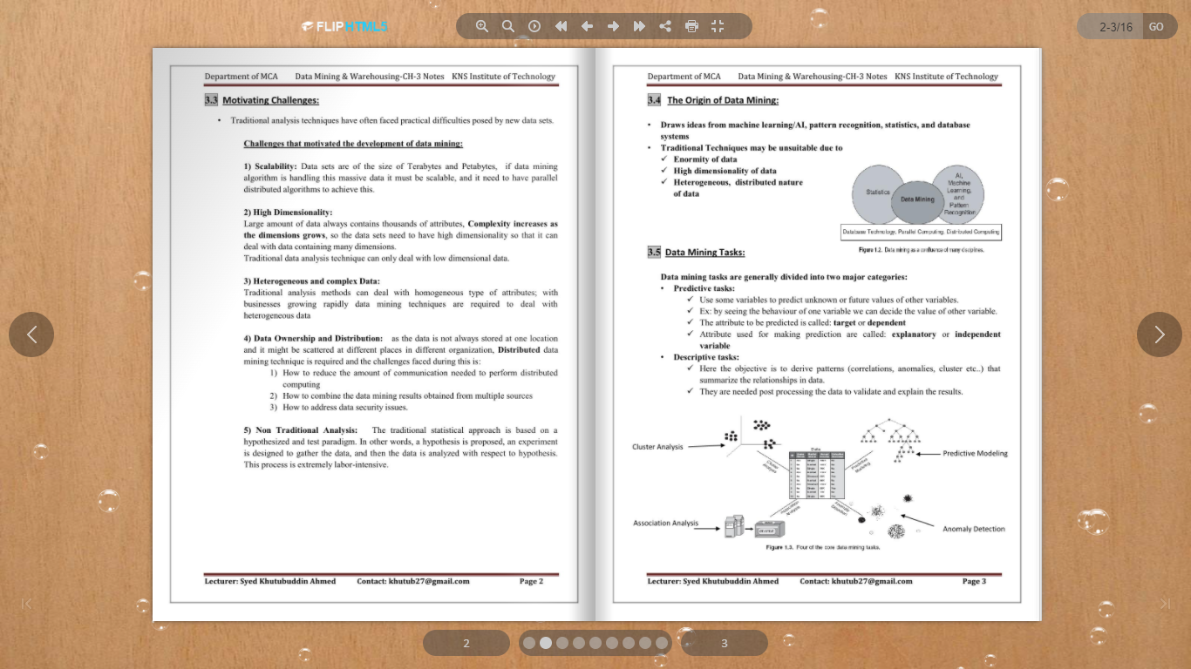

Slide 4
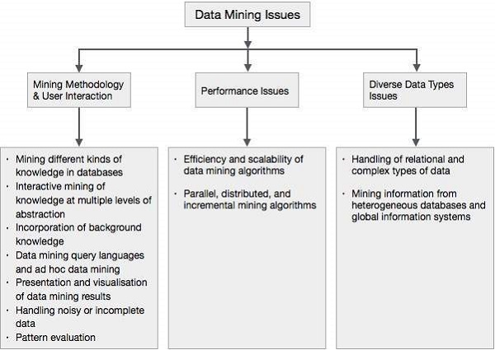

Slide 5
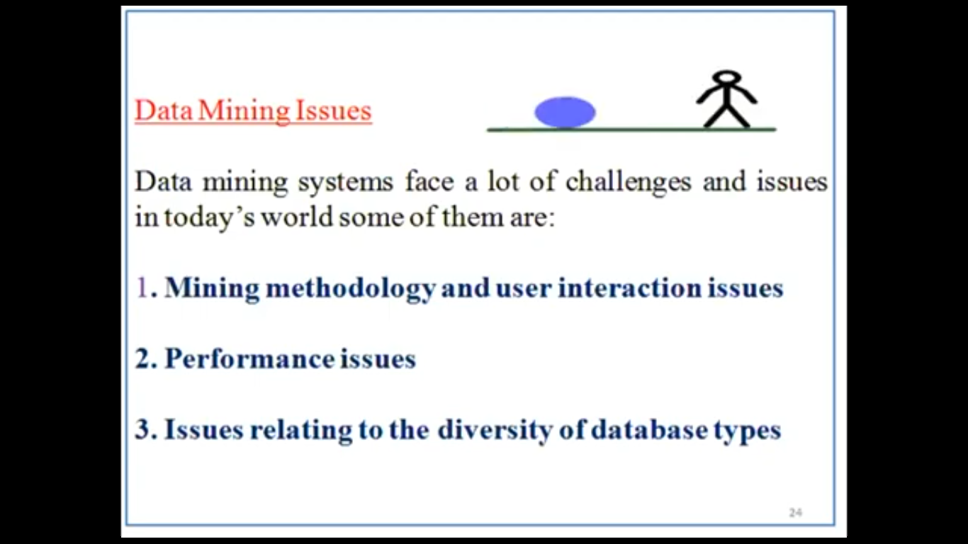

Slide 6
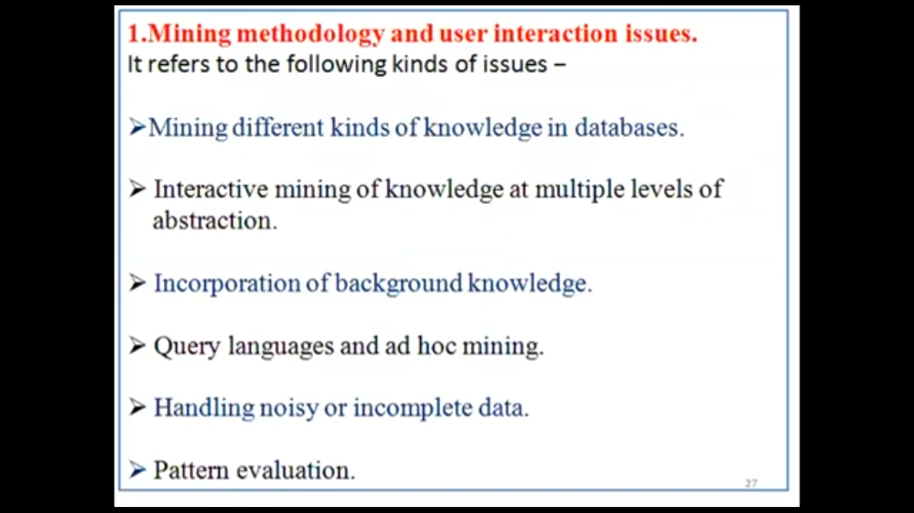

Slide 7
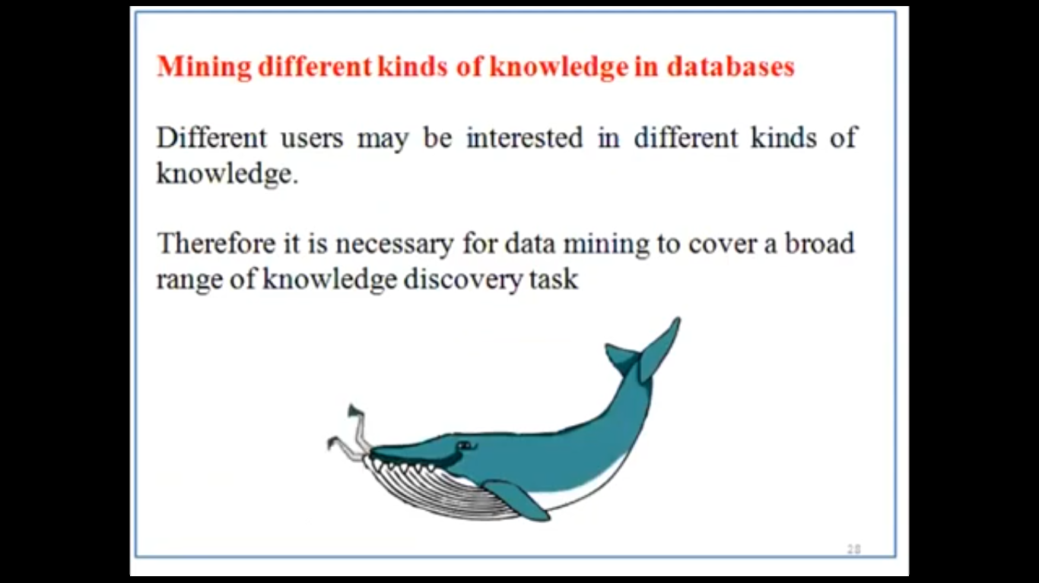

Slide 8
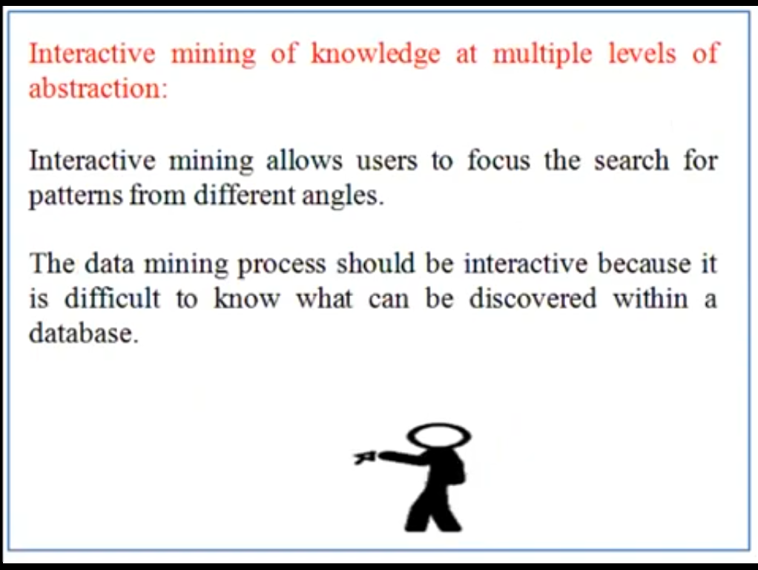

Slide 9
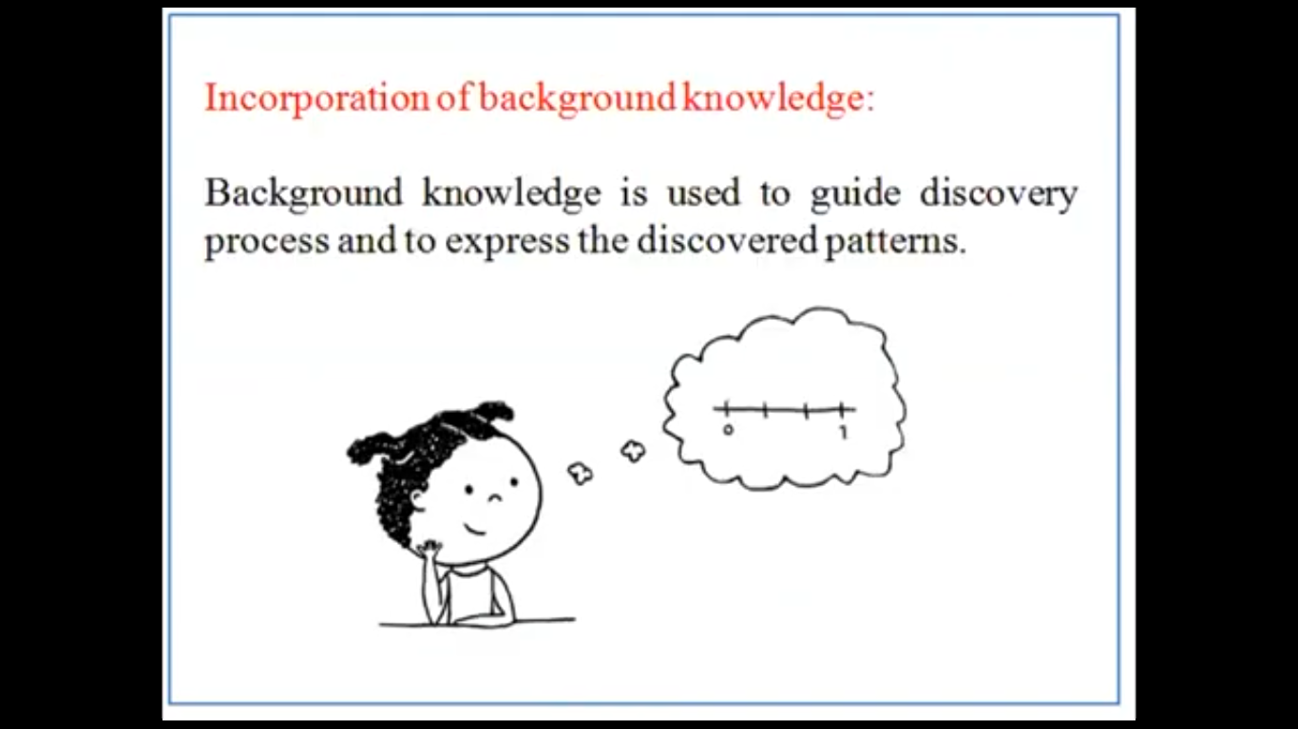

Slide 10
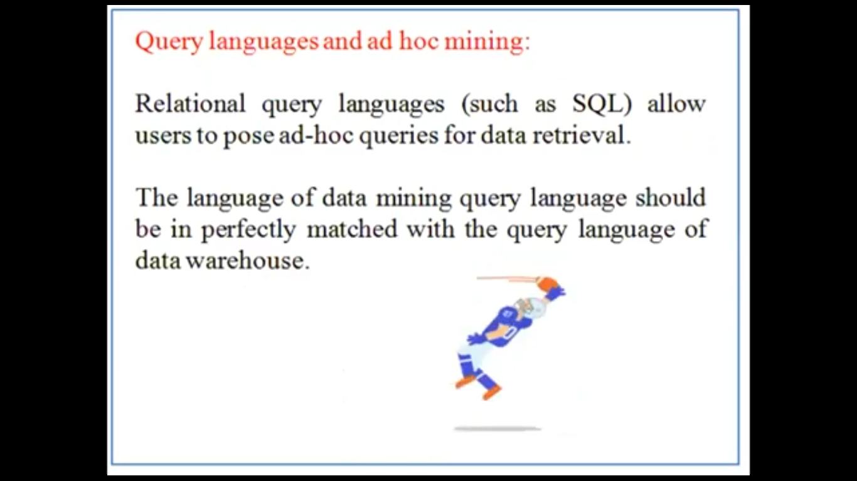

Slide 11
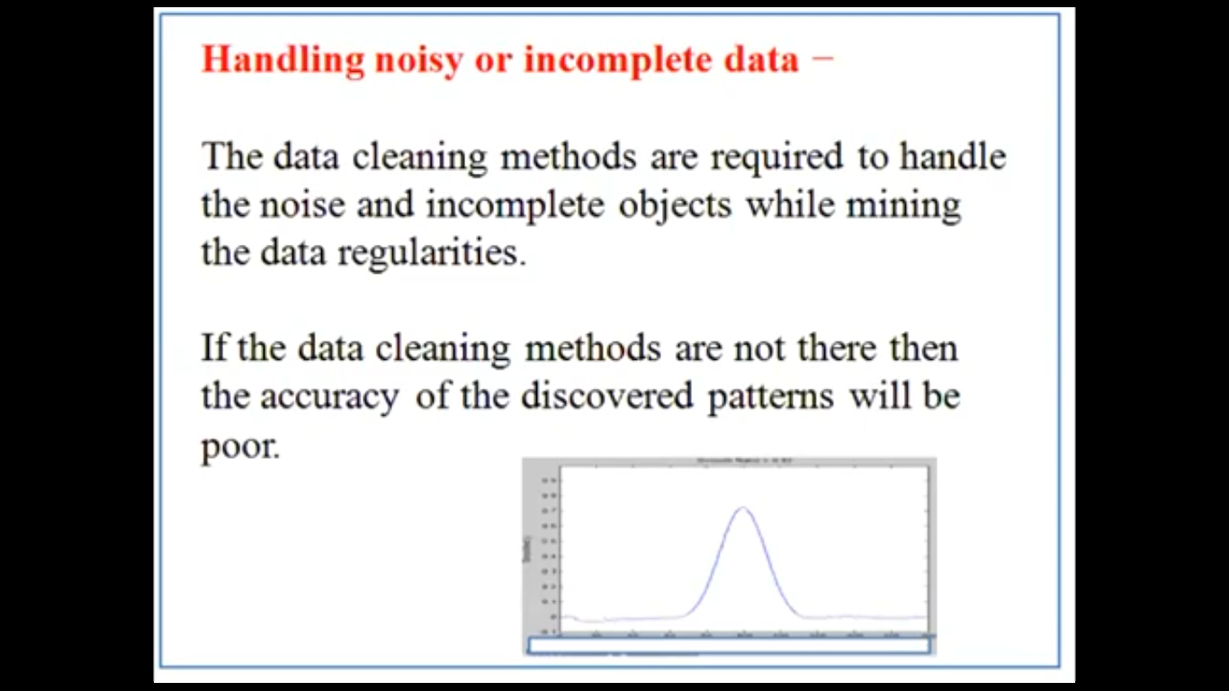

Slide 12
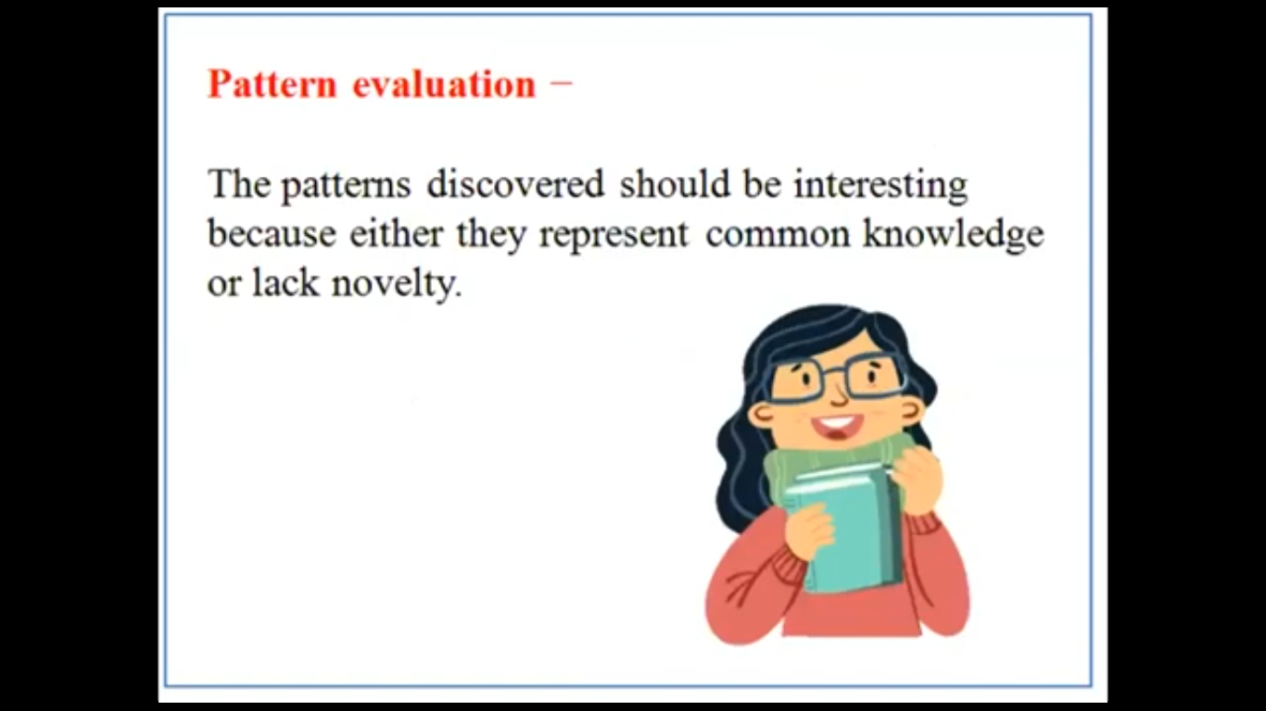

Slide 13
Performance Issues:
There can be performance-related issues such as follows −
Efficiency and scalability of data mining algorithms − In order to effectively extract the information from huge amount of data in databases, data mining algorithm must be efficient and scalable.
Parallel, distributed, and incremental mining algorithms − The factors such as huge size of databases, wide distribution of data, and complexity of data mining methods motivate the development of parallel and distributed data mining algorithms. These algorithms divide the data into partitions which is further processed in a parallel fashion. Then the results from the partitions is merged. The incremental algorithms, update databases without mining the data again from scratch.

Slide 14
Diverse Data Types Issues
Handling of relational and complex types of data − The database may contain complex data objects, multimedia data objects, spatial data, temporal data etc. It is not possible for one system to mine all these kind of data.
Mining information from heterogeneous databases and global information systems − The data is available at different data sources on LAN or WAN. These data source may be structured, semi structured or unstructured. Therefore mining the knowledge from them adds challenges to data mining

Slide 15
Data Mining Applications
Mining technology includes lots of applications whose data will be used for analytics.
1. Communications - Data mining techniques are employed in the field of communications to forecast the behavior of consumers to create specific and targeted advertising campaigns.
2. Insurance - Data mining assists insurance companies to price their products competitively and also to advertise new offerings to their perspective as well as existing clients.
3. Education - Data mining can help educators analyze student data, forecast performance levels, and pinpoint the students or even groups of pupils who require more focus. For instance, students who have a weak grasp of maths are likely to be weak.
4. Manufacturing - With the aid of Data Mining Manufacturers can predict the wear and tear of their production equipment. They can predict maintenance, which allows them to reduce their costs to reduce the time to repair.
5. Banking - Data mining assists the finance industry gain a better understanding of the risks in the market and managing compliance with regulations. It assists banks in identifying likely defaulters and deciding whether or not to issue credit loans, cards, etc

Slide 16
6. Retail - Data Mining methods help retailers stores and malls to find and place the most lucrative items and unknown objects in the most efficient places. They assist store owners in coming up with incentives to encourage customers to spend more.
7. Service Providers - Mobile phone service providers and utilities make use of Data Mining to predict the reasons why customers leave their business. They study billing data and customer service interactions as well as complaints and complaints submitted to the company and give the customer a probability score, and provide incentives.
8. E-Commerce - Websites that sell products online use Data Mining tasks to offer cross-sells and up-sells on their sites. The most renowned brand is Amazon which uses Data Mining techniques to draw more customers to the eCommerce store.
9. Super Markets - Data Mining allows supermarket's develop rules to determine if the customers they serve were most likely to expect. Based on their shopping habits and identifying women shoppers who are likely to be expecting. They could start focusing on products such as baby powder or diapers, baby shops, and more.
10. Crime Investigation - Data Mining helps crime investigation agencies in deploying police forces (where is the crime most likely to occur and at what point? ) and for fraud detection who should be searched at the border crossing, action of frauds, etc.
11. Optimization of operations - Process mining utilizes data mining strategies to lower costs across various functional areas, allowing companies to function more efficiently. This method has helped uncover bottlenecks that cost money and enhance the decision-making process of business leaders.

Slide 17
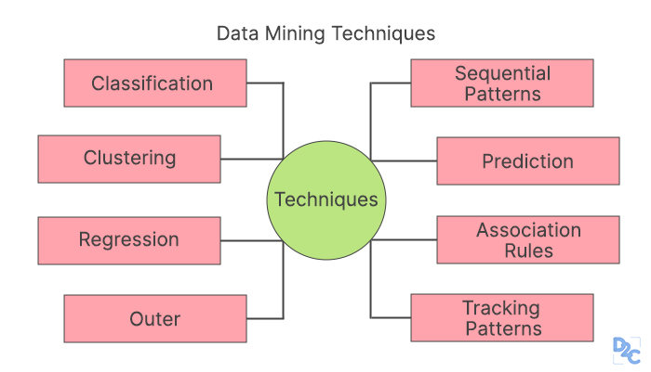

Slide 18
Data Mining Techniques Techniques of data mining can be defined by object-oriented and object-relational databases.
1. Classification
This analysis can be used to find important and pertinent data information, as well as metadata. This method of data mining helps to categorize data into various categories.
2. Clustering
The clustering process is a mining technique that helps to find data that are similar to each other. This helps in understanding the similarities and differences between the data.
3. Regression
Regression analysis is a method for mining data that identifies and studies the relationships between variables. It can be used to determine the probabilities of a certain variable in light of the presence of additional variables.
4. Association Rules
This method of data mining assists to discover the relationship between the two and more Items. It finds an undiscovered pattern within the set of data.
5. Outer detection
This particular type of data mining method is the observations of data elements in the data that don't match the pattern expected or behavior. This technique is used in a wide range of areas like intrusion detection of fraud, fault detection, and so on. Outer detection can also be referred to as Outlier Analysis and Outlier mining.

Slide 19
6. Sequential Patterns
This technique of data mining helps to identify or discover patterns or trends that are similar in transactions for a specific period.
7. Prediction
Mining Prediction is a mix with other methods of data mining such as patterns that repeat, trends and clustering, classification, and more. studies past events or events in a proper sequence to anticipate the outcome of a future event.
8. Tracking Pattern
The tracking of patterns is an essential method for data mining. It involves identifying and monitoring patterns or trends that are present in the data to draw predictions about business results. When an organization has identified trends for sales statistics, say it's time to consider making a decision to take advantage of that knowledge
Eample: A bank is looking for ways to generate more revenue from credit card transactions. They would like to determine if the user could double if fees were cut by half.
Bank has several years of data for average price and credit card balances and the number of payments, use of credit limits, as well as other crucial factors. They build a model to evaluate the effect of the new business policy. The results of the data show that reducing fees by half for customers with a targeted base can boost revenue by 10 million dollars.

Slide 20
Data Mining Tools
Here are two of the most popular Data Mining tools that are widely used in Industry
1. R-language
The language r is an open-source tool to use statistical computing and graphics. R offers a variety of classical tests in statistics, time-series analyses classification, as well as graphical methods. It is a powerful data storage and data handling system.
2. Oracle Data Mining
Oracle Data Mining popularly knowns as ODM is a module within the Oracle Advanced Analytics Database. It is a Data mining tool that lets data analysts produce detailed insights and make mining predictions. Oracle data mining assists in predicting customer behavior and creates profiles for customers. It also identifies cross-selling opportunities.

Slide 21
Advantages of Data Mining
Data mining is a technique that helps businesses to gather information based on knowledge. It triggers new business questions to develop more ideal models.
Data mining assists companies to make profitable changes to production and operation.
Data mining is an efficient and cost-effective option when compared with other data mining applications based on statistical data.
Data mining can aid in the process of making decisions.
Learning of automated forecasting of patterns and patterns automates the discovery of patterns hidden from view.
It can be utilized in brand new systems, as well as on existing platforms
It's a speedy method that allows users to process large amounts of data in a shorter time by using deep learning algorithms and machine learning algorithms.
Clustering or unsupervised learning techniques are employed to identify natural patterns or patterns in the data, even when the group's membership or category was not known previously.

Slide 22
Disadvantages of Data Mining
There is a possibility that companies sell user data of their clients to other companies in exchange for cash. For instance, American Express has sold purchases made by credit cards of their customers to other businesses.
Many of the data mining analytics programs are difficult to use and require extensive education to operate.
Different data mining tools function in various ways due to the different algorithms utilized in their creation. So, choosing the appropriate data mining software is an extremely difficult job.
The techniques used to mine data aren't accurate therefore it could be a cause of serious harm in certain circumstances.

Slide 23
Data Mining Applications
Mining technology includes lots of applications whose data will be used for analytics.
1. Communications - Data mining techniques are employed in the field of communications to forecast the behavior of consumers to create specific and targeted advertising campaigns.
2. Insurance - Data mining assists insurance companies to price their products competitively and also to advertise new offerings to their perspective as well as existing clients.
3. Education - Data mining can help educators analyze student data, forecast performance levels, and pinpoint the students or even groups of pupils who require more focus. For instance, students who have a weak grasp of maths are likely to be weak.
4. Manufacturing - With the aid of Data Mining Manufacturers can predict the wear and tear of their production equipment. They can predict maintenance, which allows them to reduce their costs to reduce the time to repair.
5. Banking - Data mining assists the finance industry gain a better understanding of the risks in the market and managing compliance with regulations. It assists banks in identifying likely defaulters and deciding whether or not to issue credit loans, cards, etc.
6. Retail - Data Mining methods help retailers stores and malls to find and place the most lucrative items and unknown objects in the most efficient places. They assist store owners in coming up with incentives to encourage customers to spend more.

Slide 24
7. Service Providers - Mobile phone service providers and utilities make use of Data Mining to predict the reasons why customers leave their business. They study billing data and customer service interactions as well as complaints and complaints submitted to the company and give the customer a probability score, and provide incentives.
8. E-Commerce - Websites that sell products online use Data Mining tasks to offer cross-sells and up-sells on their sites. The most renowned brand is Amazon which uses Data Mining techniques to draw more customers to the eCommerce store.
9. Super Markets - Data Mining allows supermarket's develop rules to determine if the customers they serve were most likely to expect. Based on their shopping habits and identifying women shoppers who are likely to be expecting. They could start focusing on products such as baby powder or diapers, baby shops, and more.
10. Crime Investigation - Data Mining helps crime investigation agencies in deploying police forces (where is the crime most likely to occur and at what point? ) and for fraud detection who should be searched at the border crossing, action of frauds, etc.
11. Optimization of operations - Process mining utilizes data mining strategies to lower costs across various functional areas, allowing companies to function more efficiently. This method has helped uncover bottlenecks that cost money and enhance the decision-making process of business leaders

Slide 25
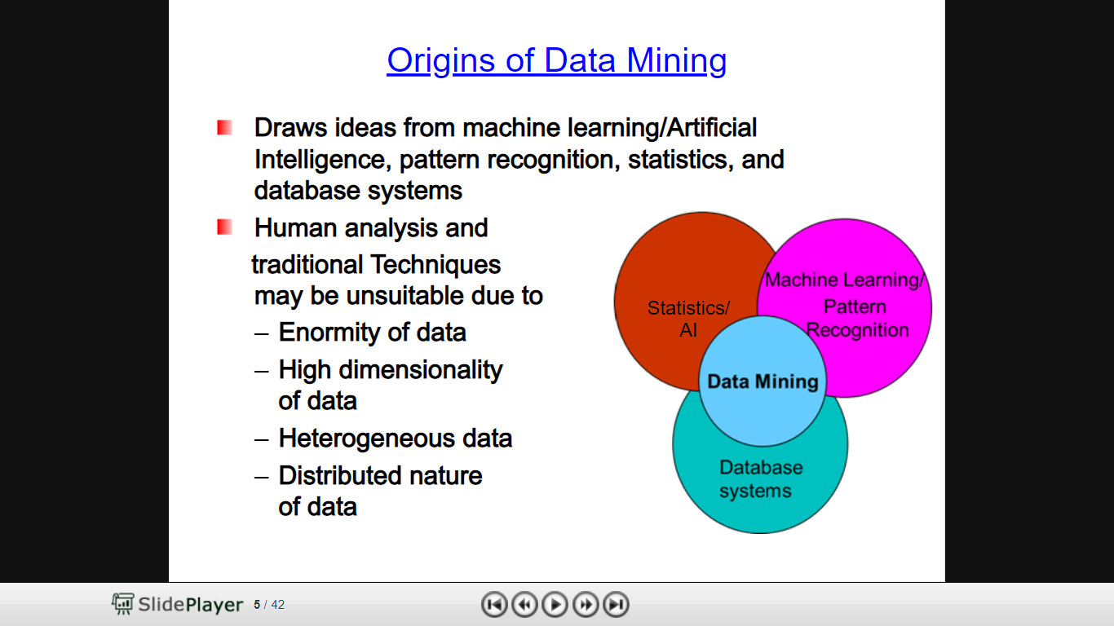

Slide 26
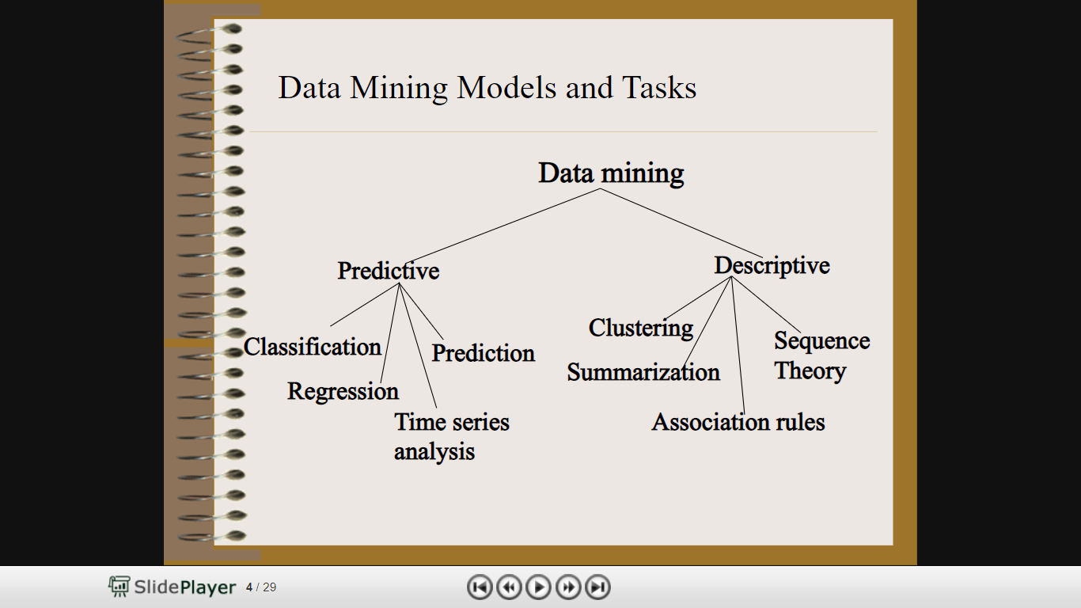

Slide 27
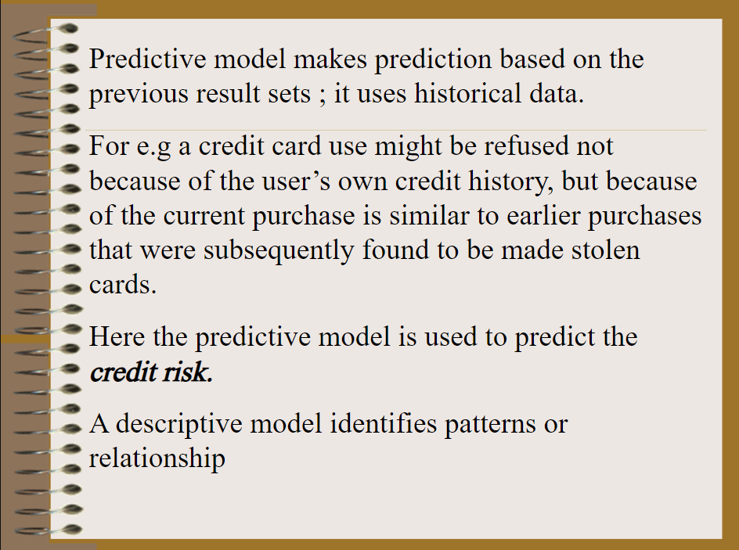

Slide 28
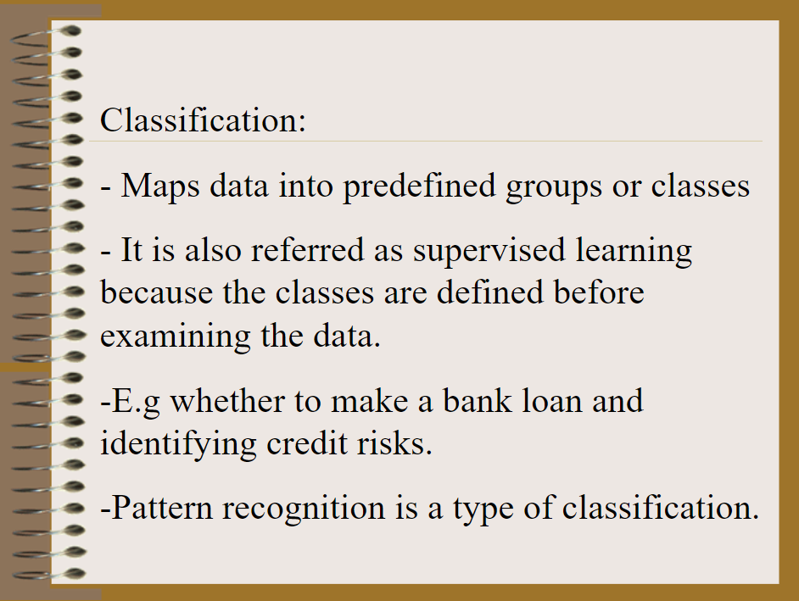

Slide 29
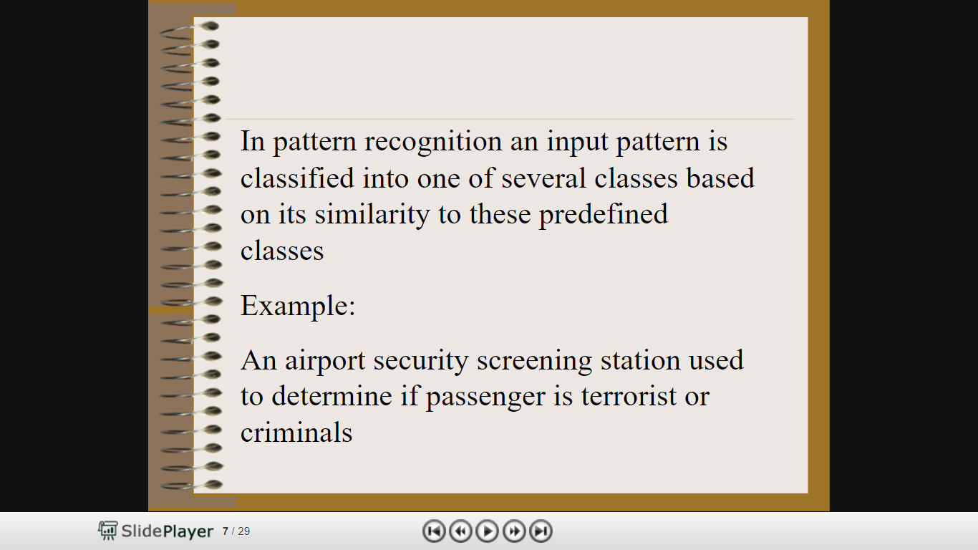

Slide 30
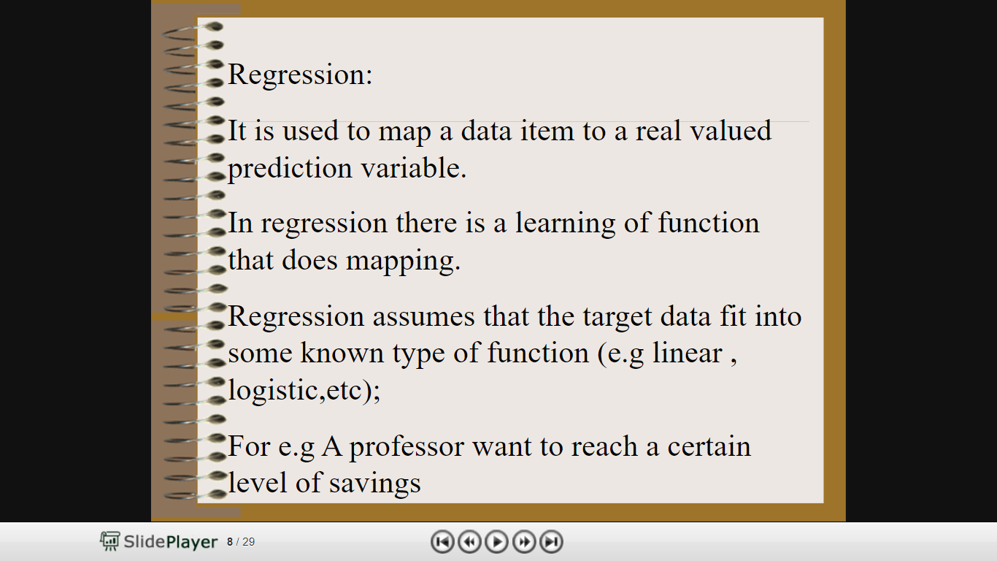

Slide 31
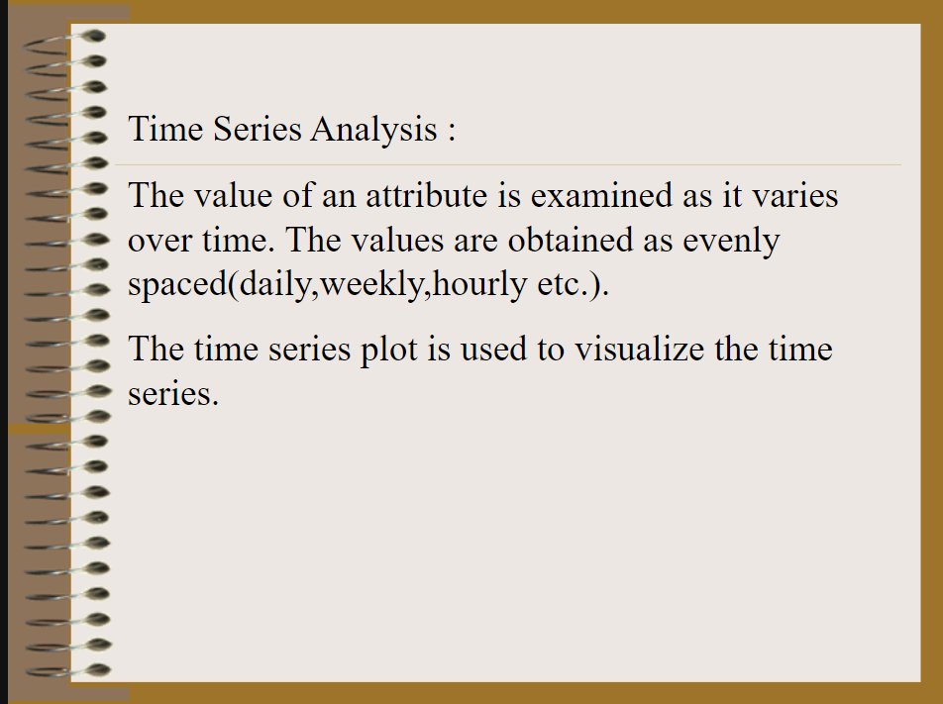

Slide 32
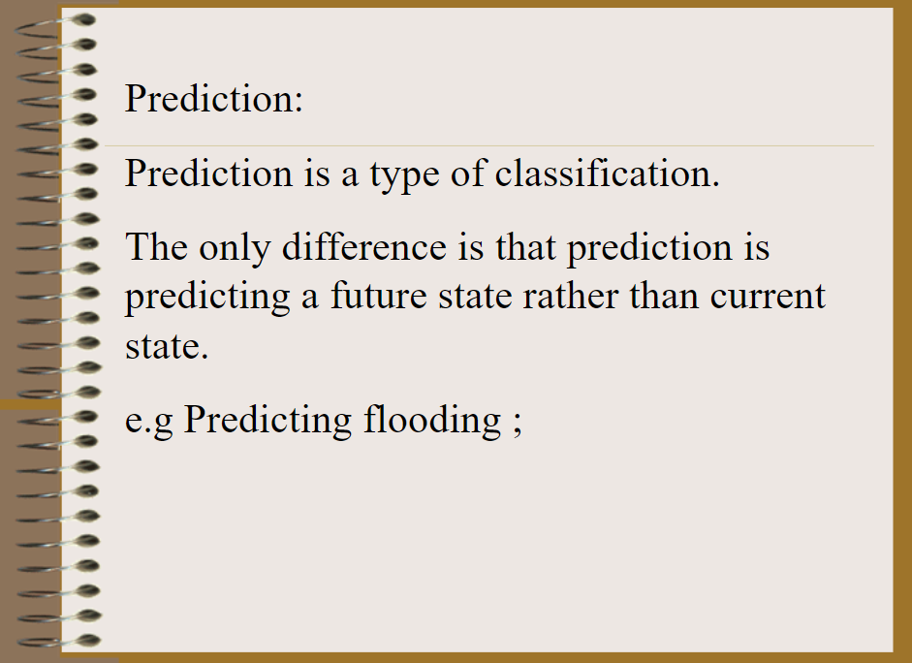

Slide 33
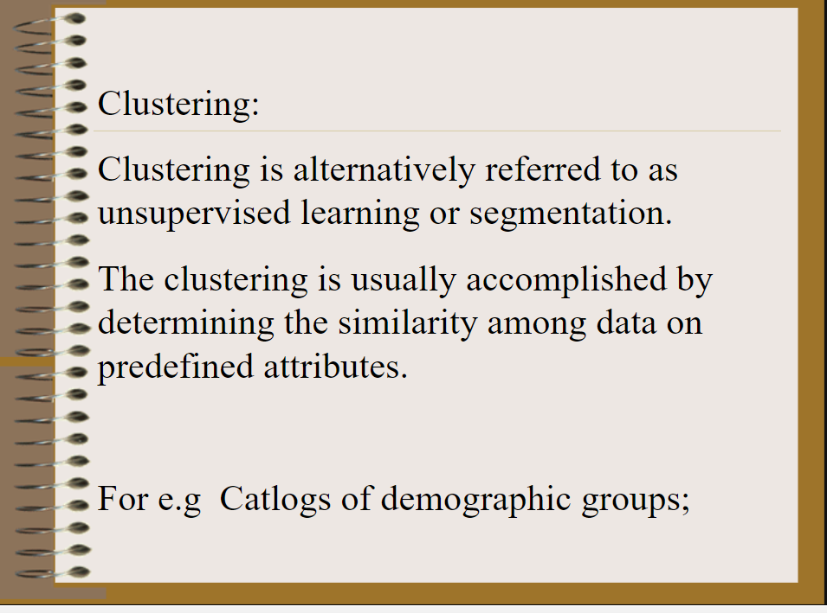

Slide 34
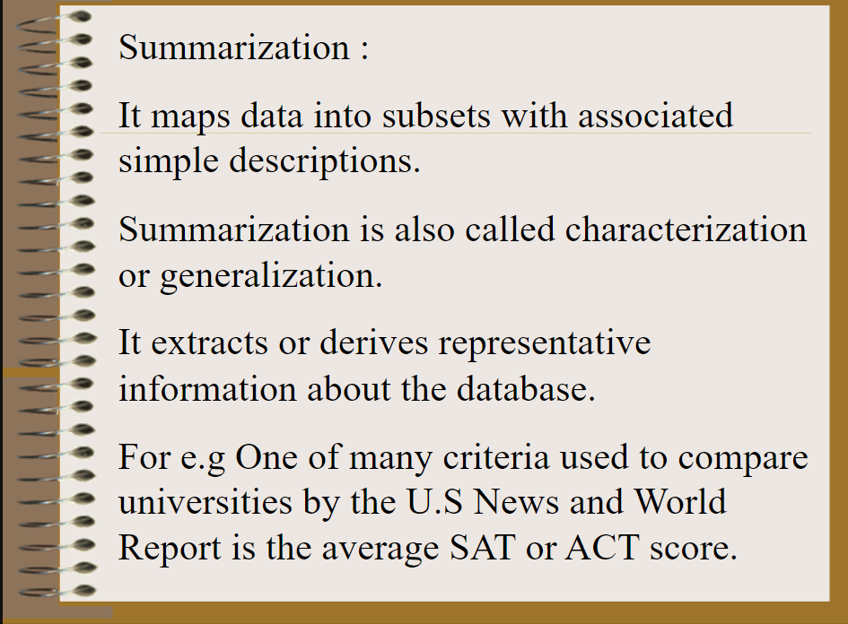

Slide 35
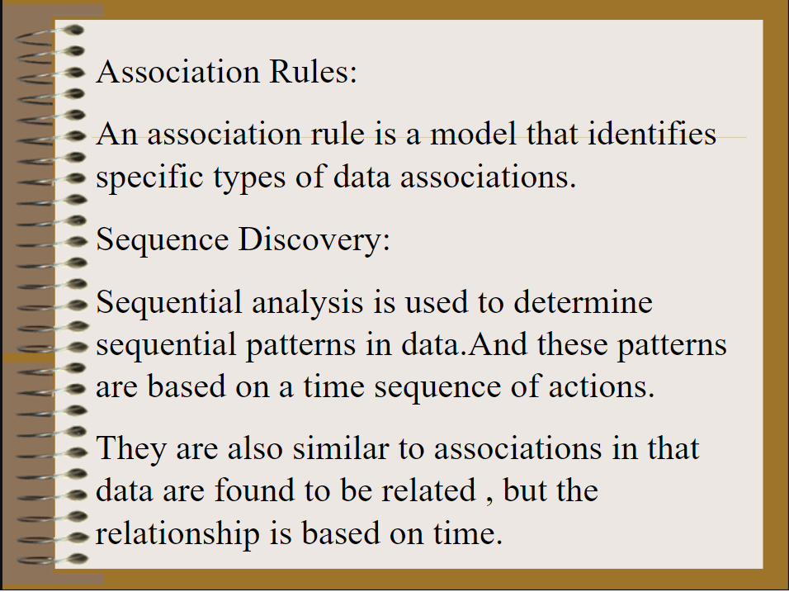

Slide 36
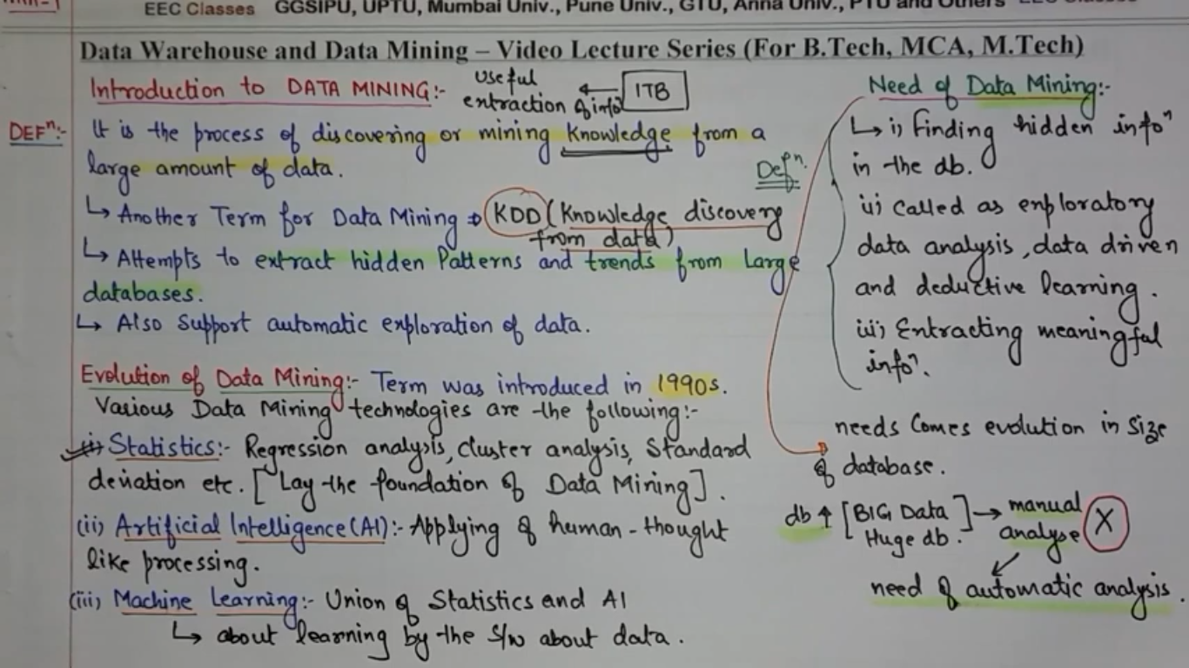

Slide 37
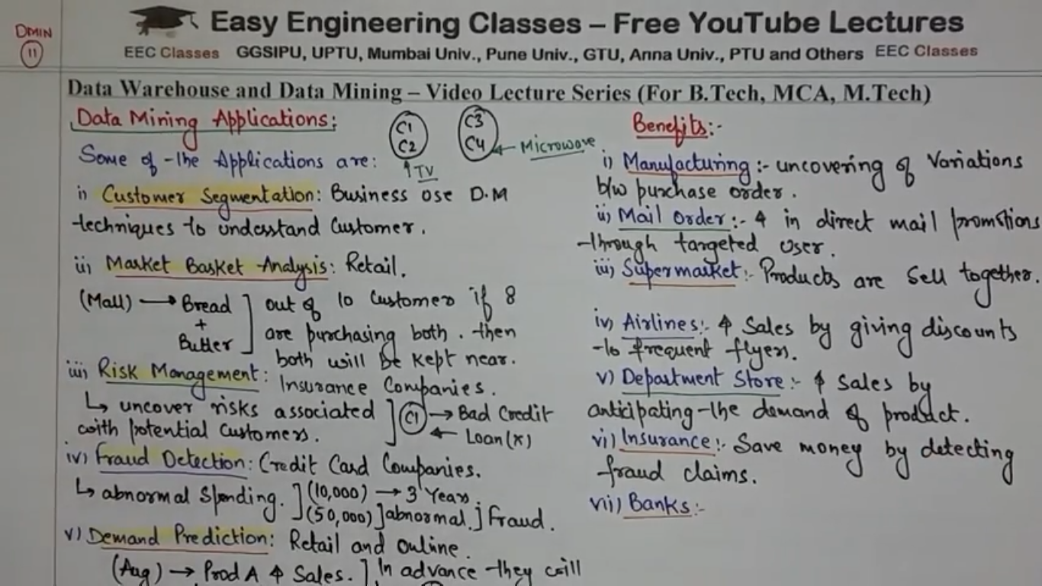

Slide 38
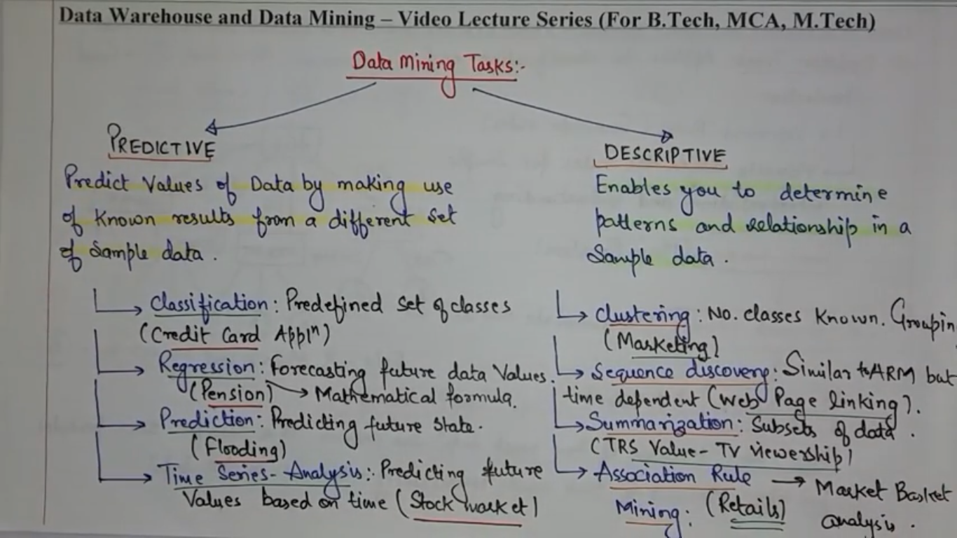

Slide 39
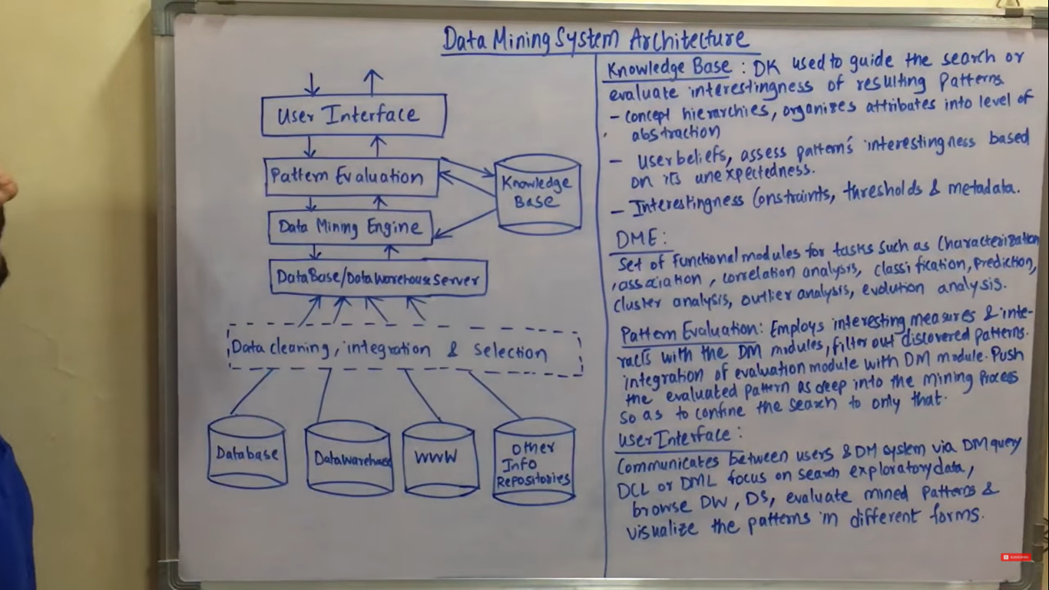

Slide 41
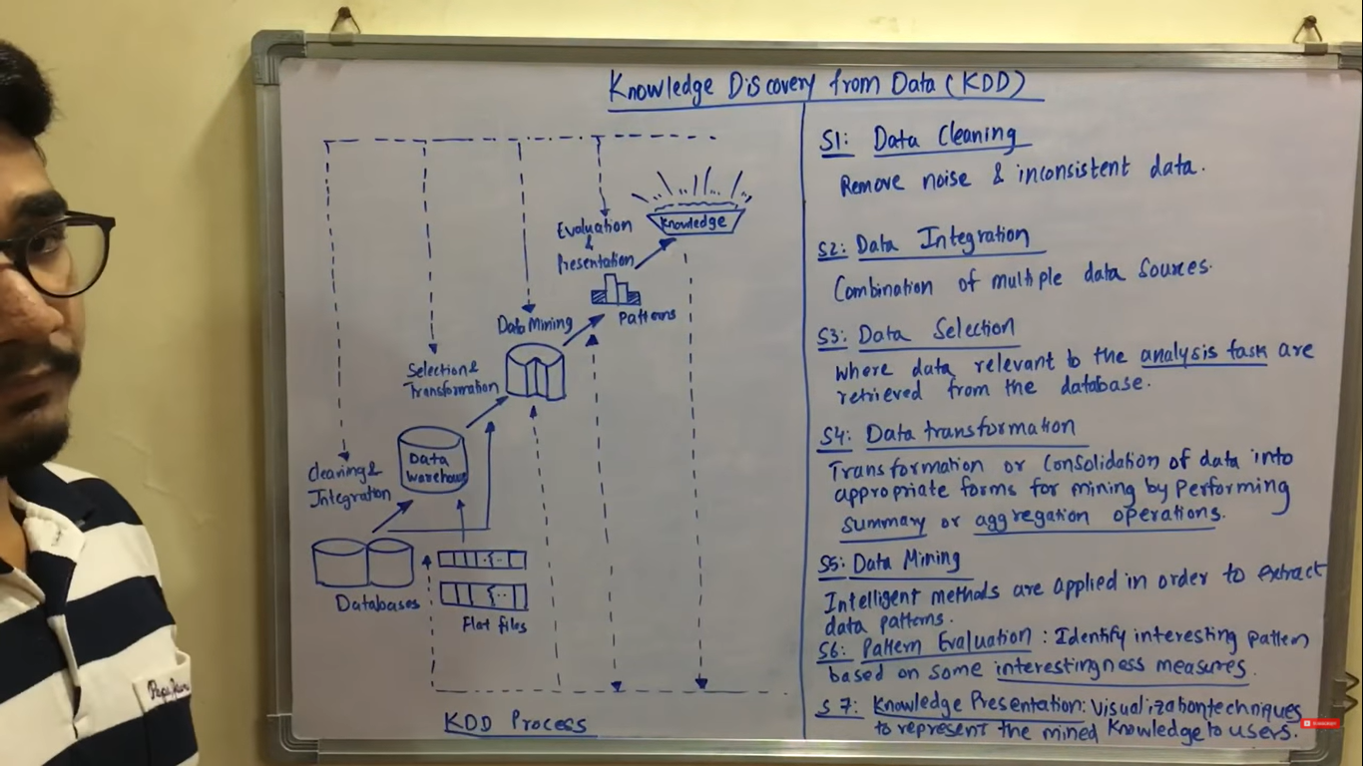

Slide 42
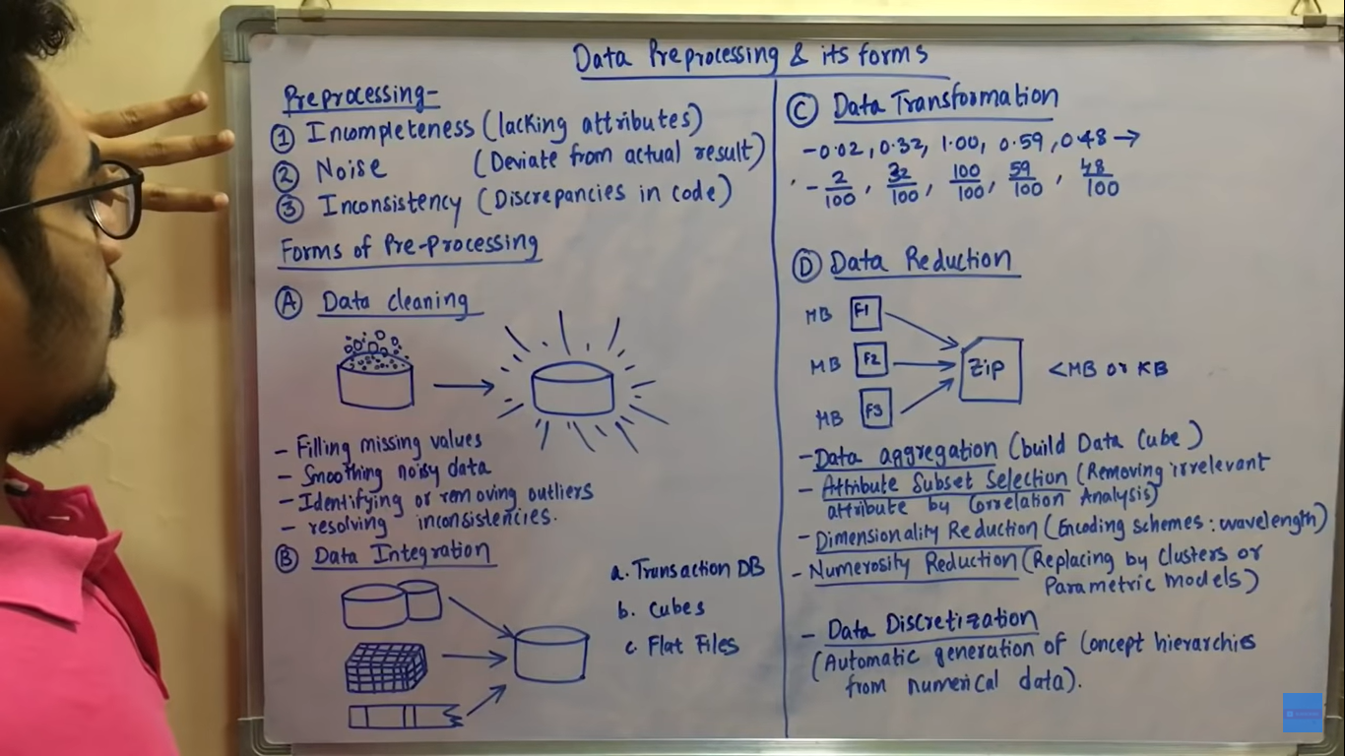

Slide 43
Data mining: Data mining is defined as procedure of extracting information from huge set of data. It is also known as mining knowledge from data.
What types of data can be mined .?
Data can be mined in 3 types of data.
1.database data(RDBMS):A data base usually controlled by dbms,in dbms data is stored in rows (tuple) and columns(ttributes) of tables to make the processing of data.
In database data can be easily accessed,mananged, modifies, updated, controlled and organized.
Most data bases use structural query language for writing and query the data.
While mining data bases we can search for trends or data patterns.
Ex: max,min,count,total,rank,mode,median.
Different types of data can be mined
Anlysing customer data to predict the credit risk of new customers based on rawdata.

Slide 44
Data warehouse data: collection of data integrated from different sources with querying data decision making on data. In Data warehouse ,data is stored in multidimensional structure(data cube) where each dimension is each attribute.

Slide 45
TRADITIONAL DATABASE: Each record is called as transaction(sales, flightbooking, userclicks on webpages. Each transaction has transaction ID ,list other items m transaction king transaction from db,we can mine frequent patterns.
Other databases: sequence data,datastreams,spatial data,engineering design data,hypertext,multimedia,webdata etc.

Slide 46
DATA MINING FUNCTIONALITIES:
1.CONCEPT/ CLASS DESCRIPTIONS: the simplest kind of descriptive data mining Is called concept description. A concept usually refers to the collection of data such as frequent_buyers, graduate_student and so on.
A data mining task concept description is not a simple enumeration of the data. instead,concept description generates descriptions for characterization and comparision of data.
It is sometimes called as class description, when the concept to be described refers to the a class of object.
Characterization: provides a concise and brief summarization of the given collection of data.
Comparision: provides descriptions comparing two or more collections of data.

Slide 47
2.Mining frequent patterns,association &coreltions.
Frequent patterns: Things which are found most commonly in data.
Frequent item sets
Frequent subsequences
Frequent substructures
Association analysis: it is Frequent way of identifying the relation between various items.
Examples: Used to determine sales of items that are frequently purchased together.
Correlation analysis: it is a mathematical techniue
Shows how strongly pair of attribute are related together.
Ex: tall peoples tend to have more weight.

Slide 48
3.Classification and regression analysis:
cl

Slide 49
Data preprocessing: The processing of transforming (convert) raw data into understandable format.
There are 4 major tasks in Data preprocessing.
1.Data Cleaning.
2.Dataintegration.
3.Datareduction
4.Datatransformation.

Slide 50
Preprocessing in Data Mining: Data preprocessing is a data mining technique which is used to transform the raw data in a useful and efficient format.
Steps Involved in Data Preprocessing:
Data Cleaning: The data can have many irrelevant and missing parts. To handle this part, data cleaning is done. It involves handling of missing data, noisy data etc.
(a). Missing Data: This situation arises when some data is missing in the data. It can be handled in various ways. Some of them are:
Ignore the tuples: This approach is suitable only when the dataset we have is quite large and multiple values are missing within a tuple.
Fill the Missing values: There are various ways to do this task. You can choose to fill the missing values manually, by attribute mean or the most probable value. (b). Noisy Data: Noisy data is a meaningless data that can’t be interpreted by machines.It can be generated due to faulty data collection, data entry errors etc. It can be handled in following ways :

Slide 51
Binning Method: Binning: This method is to smooth or handle noisy data. First, the data is sorted then and then the sorted values are separated and stored in the form of bins. There are three methods for smoothing data in the bin.
Smoothing by bin mean method: In this method, the values in the bin are replaced by the mean value of the bin;
Smoothing by bin median: In this method, the values in the bin are replaced by the median value;
Smoothing by bin boundary: In this method, the using minimum and maximum values of the bin values are taken and the values are replaced by the closest boundary value.
Regression: This is used to smooth the data and will help to handle data when unnecessary data is present. For the analysis, purpose regression helps to decide the variable which is suitable for our analysis.
REGRESSION analysis is a set of statistical process for estimating relationship between dependent variables one or more.
Clustering: This is used for finding the outliers and also in grouping the data. Clustering is generally used in unsupervised learning.

Slide 52
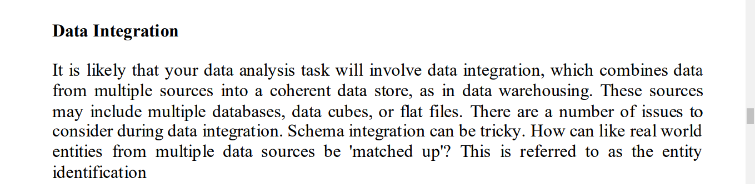
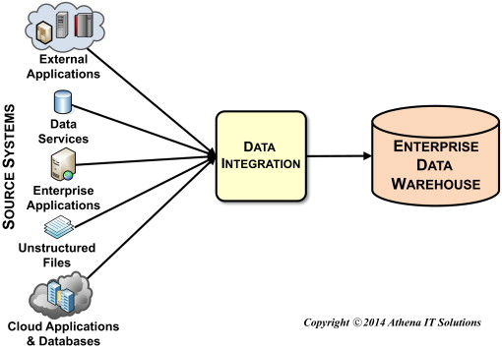
2.Data integration: The process of combining multiple sources into a single dataset. The data integration process is one of the main components in data management.

Slide 53
3. Data Reduction: Since data mining is a technique that is used to handle huge amount of data. While working with huge volume of data, analysis became harder in such cases. In order to get rid of this, we uses data reduction technique. It aims to increase the storage efficiency and reduce data storage and analysis costs.
The various steps to data reduction are:
Data Cube Aggregation: Aggregation operation is applied to data for the construction of the data cube.
Attribute Subset Selection: The highly relevant attributes should be used, rest all can be discarded. For performing attribute selection, one can use level of significance and p- value of the attribute.
the attribute having p-value greater than significance level can be discarded.
Numerosity Reduction: This enable to store the model of data instead of whole data, for example: Regression Models.
Dimensionality Reduction: This reduce the size of data by encoding mechanisms.It can be lossy or lossless. If after reconstruction from compressed data, original data can be retrieved, such reduction are called lossless reduction else it is called lossy reduction. The two effective methods of dimensionality reduction are:Wavelet transforms and PCA (Principal Component Analysis).

Slide 54
4. Data Transformation: This step is taken in order to transform the data in appropriate forms suitable for mining process. This involves following ways:
Aggregation: Data aggregation combines all of your data together in a uniform format.
Normalization: It is done in order to scale the data values in a specified range (-1.0 to 1.0 or 0.0 to 1.0)
Attribute Selection: In this strategy, new attributes are constructed from the given set of attributes to help the mining process.
Discretization: This is done to replace the raw values of numeric attribute by interval levels or conceptual levels.
10,20,30,40,50,60,70,80,90 range is 10 to 90
Concept Hierarchy Generation: Here attributes are converted from lower level to higher level in hierarchy. For Example-The attribute “city” can be converted to “country”.

Slide 55



